Slide 1
Anonymous Communication
04
Kai Bu
kaibu@zju.edu.cn
http://list.zju.edu.cn/kaibu/netsec2022

Slide 2
Anonymous Communication
Disclaimer:
The content to be presented aims only for
helping students understand principles of
anonymous communication. It should not be
used for abusive Internet activities.

Slide 3



Anonymous Communication
zb
zc
hello, zc
Notes:
Exchange messages

Slide 4

Anonymous Communication
zb
Internet
zc
hello, zc
Notes:
Through Internet

Slide 5
Anonymous Communication
zb: ip1
Internet
ip2 :
zc
hello, zc
Notes:
Source IP and Destination IP for specifying users

Slide 6

Anonymous Communication
jzk: ip1
???
Internet
ip2 :
???
hello, zc
Notes:
For an attacker snooping on the communication
Even though he may not know the exact identities of the two users

Slide 7
Anonymous Communication
jzk: ip1
???
Internet
ip2 :
???
asdfghjkl
Notes:
And not know the message content protected by encryption

Slide 8
Anonymous Communication
jzk: ip1
???
Internet
ip2 :
???
asdfghjkl
Notes:
He can use their IP addresses;

Slide 9
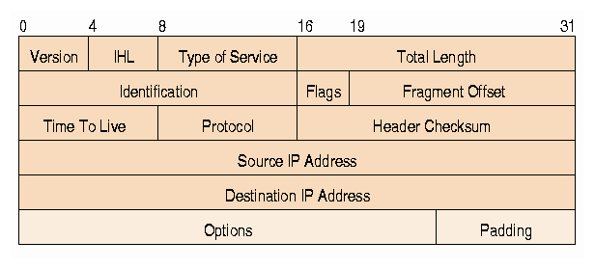
Anonymous Communication
Notes:
Because, for users to communicate via internet, their devices assigned with IP addresses,
which are usually fixed within a communication session or more;
This can be used to infer critical privacy of users

Slide 10
Anonymous Communication
anonymity & privacy:
who is communicating?
who are you talking to?
what type of activities?
what type of information?

Slide 11
Anonymous Communication
why wanted?

Slide 12
Anonymity for Mortals
Unmonitored access to health and medical information
Preservation of democracy:
anonymous election/jury
Censorship circumvention:
anonymous access to otherwise restricted information
…

Slide 13
Anonymity for Attackers
Misbehaviors without getting caught:
Terrorism
Darknet
Spam
Pirate
…

Slide 14
Anonymous Communication
how to?

Slide 15
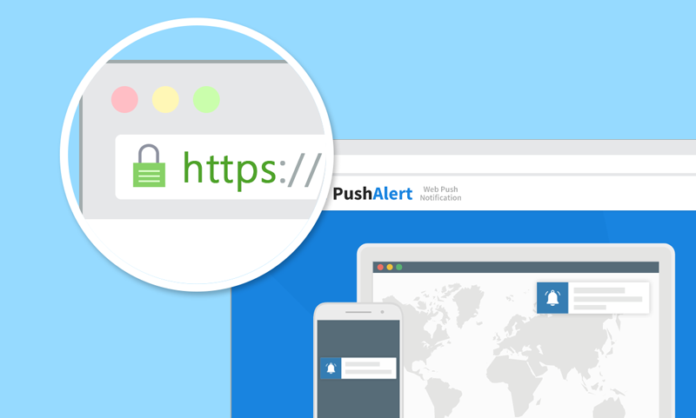
HTTPS?
asdf
Notes:
User types a link in the address bar

Slide 16
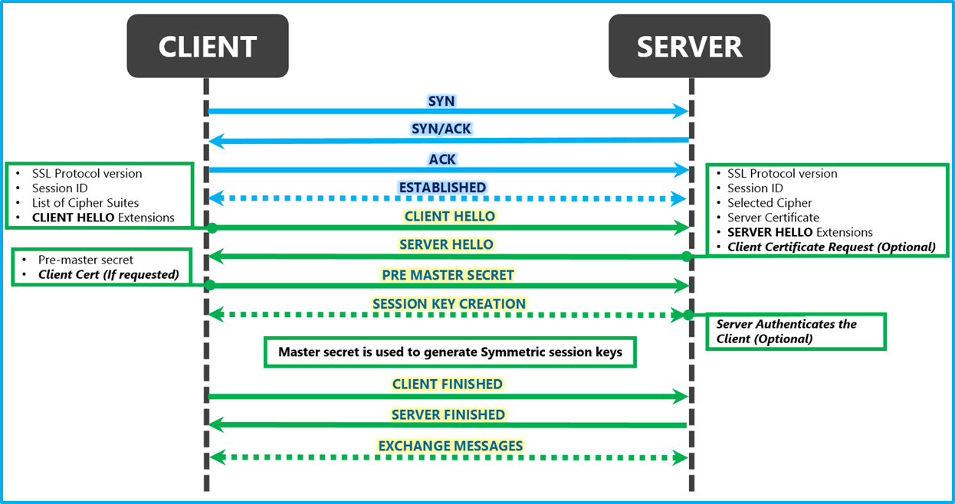

HTTPS for Confidentiality
TCP
handshake
TLS
handshake
connection
termination
FIN
FIN, ACK
ACK

Slide 17
HTTPS Not for Anonymity
TCP
handshake
TLS
handshake
connection
termination
FIN
FIN, ACK
ACK

Slide 18
HTTPS?
https://www.votefor.com
asdf
Notes:
Even if we don’t know what you communicated, knowing with
whom you communicated leaks a lot of information as well

Slide 19
Anonymous Communication
how to?
how to?
Notes:
then again, how to?

Slide 20
Anonymous Communication
hide destination address;
Notes:
Previous example: privacy about which site to connect,
So, hide destination address?

Slide 21
Anonymous Communication
hide destination address;
how to deliver packets to destination?
Notes:
However, according to routing, need to specify the ip address of destination to ensure packets being directed toward it,
Then how to deliver packets to destination?

Slide 22
Anonymous Communication
RELAY!

Slide 23

ip3
RELAY!
ip1
Internet
ip2
Notes:
Ip3 is a relay node

Slide 24
monitored:
ip1->ip3, ip3->ip2
protected:
ip1->ip2
ip3
RELAY!
ip1
Internet
ip2

Slide 25
monitored:
ip1->ip3, ip3->ip2
protected:
ip1->ip2
overlay
communication
ip3
RELAY!
ip1
Internet
ip2

Slide 26
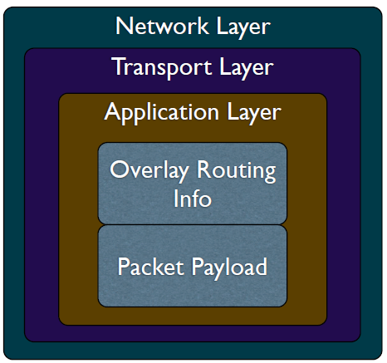
Overlay Network
Handle routing at the application layer
Tunnel messages inside other messages

Slide 27
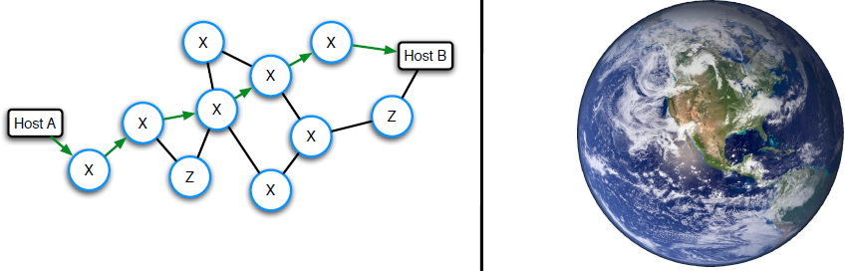
Threat Model
Insider Byzantine attacker
with limited view of network:
an attacker might have tight control over a network (e.g., Z ASes),
yet unlikely to observe entire Internet
vs

Slide 28
Threat Model
Attacker is part of the network
Insider Byzantine attacker
with limited view of network:
an attacker might have tight control over a network (e.g., Z ASes),
yet unlikely to observe entire Internet
vs

Slide 29
Threat Model
Attacker may or may not attack
Insider Byzantine attacker
with limited view of network:
an attacker might have tight control over a network (e.g., Z ASes),
yet unlikely to observe entire Internet
vs

Slide 30



Traceforward Attack
passive attacker
traces messages from sender, thwarts receiver anonymity

Slide 31
Marking Attack
active attacker
marks messages,
discovers marked msg elsewhere

Slide 32
Anonymous Communication
anonymizing proxy

Slide 33

Anonymizing Proxy

Slide 34
Anonymizing Proxy
intermediary between sender & receiver
Sender relays all traffic through proxy
Encrypt destination and payload

Slide 35
Anonymizing Proxy
intermediary between sender & receiver
Sender relays all traffic through proxy
Encrypt destination and payload
Asymmetric technique:
receiver not involved (or informed of) anonymity

Slide 36

Anonymizing Proxy
k: shared key of sender and proxy
proxy
sender
receiver
1
2
{msg,dest}_{k}
msg
{response}_{k}
response
4
3

Slide 37
Anonymizing Proxy
k: shared key of sender and proxy
if attacker is located between
sender and proxy:
sender anonymity:
receiver anonymity:
0:
1
proxy
sender
receiver
{msg,dest}_{k}
msg
{response}_{k}
response
Notes:
In this example, more about which entity is communicating with proxy

Slide 38
Anonymizing Proxy
k: shared key of sender and proxy
if attacker is located between
proxy and receiver:
sender anonymity:
receiver anonymity:
1:
0
proxy
sender
receiver
{msg,dest}_{k}
msg
{response}_{k}
response
Notes:
More about which entity is communicating with proxy

Slide 39
Anonymizing Proxy
k: shared key of sender and proxy
if two attackers collude to correlate
ingress and egress proxy traffic:
sender anonymity:
receiver anonymity:
0:
0
proxy
sender
receiver
{msg,dest}_{k}
msg
{response}_{k}
response
Notes:
Yet in practical, require sophosticated traffic correlation techniques

Slide 40
Anonymizing Proxy
If attacker is the proxy per se:
decrypt all messages;
crack both confidentiality & anonymity;
sender anonymity:
receiver anonymity:
0:
0
proxy
sender
receiver
{msg,dest}_{k}
msg
{response}_{k}
response

Slide 41
what if receiver is attacker?

Slide 42
what if receiver is attacker?
protect sender anonymity from receiver

Slide 43

Receiver as Attacker
Known-location attacker
Use proxy to protect sender anonymity:
do not vote for letting votefor website
know that I accessed votefor /wink
proxy
votefor
sender
Notes:
Known-location attacker, as the website to hide from is kn

Slide 44
Receiver as Attacker
Known-location attacker
Use proxy to protect sender anonymity:
do not vote for letting votefor website
know that I accessed votefor /wink
have to trust
proxy
votefor
sender

Slide 45
Anonymizing Proxy
Advantages
Easy to configure
Require no active participation of
receiver, which need not be aware of
anonymity service
Have been widely deployed on Internet

Slide 46
Anonymizing Proxy
Disadvantages
Require trusted third party
proxy may release logs,
or sell them,
or blackmail sender
Anonymity largely depends on the
(likely unknown) location of attacker

Slide 47
how to evade attacker?

Slide 48
how to evade attacker?
dynamize proxy location

Slide 49
Crowds Algorithm
Basic idea:
get lost in a crowd
Jump from one crowd to another
Members of a crowd called Jondos

Slide 50
Crowds Algorithm
Algorithm:
Relay message to random jondo
With probability p, jondo forwards
message to another jondo
With probability 1-p, jondo delivers
message to its intended destination

Slide 51

Crowds Algorithm

Slide 52
Crowds Algorithm

Slide 53
Crowds Algorithm
p

Slide 54
Crowds Algorithm
p
1-p

Slide 55
Crowds Algorithm
{@dest, hello}_{k}
p
{@dest, hello}_{k}
1-p
hello

Slide 56
Crowds Algorithm
must trust jondos;
{@dest, hello}_{k}
p
{@dest, hello}_{k}
1-p
hello

Slide 57

Crowds Algorithm
must trust jondos;
if any message is intercepted,
receiver is trivially exposed.
{@dest, hello}_{k}
p
{@dest, hello}_{k}
1-p
hello
Notes:
Intercepted by untusted jondo

Slide 58
how to evade
untrusted proxies?

Slide 59
how to evade
untrusted proxies?

Slide 60
proxy++
how to evade
untrusted proxies?

Slide 61
hard for an attacker
to simultaneously control
too many proxies
proxy++
how to evade
untrusted proxies?

Slide 62
source routing
specify on-path routers by source
Notes:
allows a sender of a packet to partially or completely specify the route the packet takes through the network.
In contrast, in conventional routing, routers in the network determine the path incrementally based on the packet's destination

Slide 63
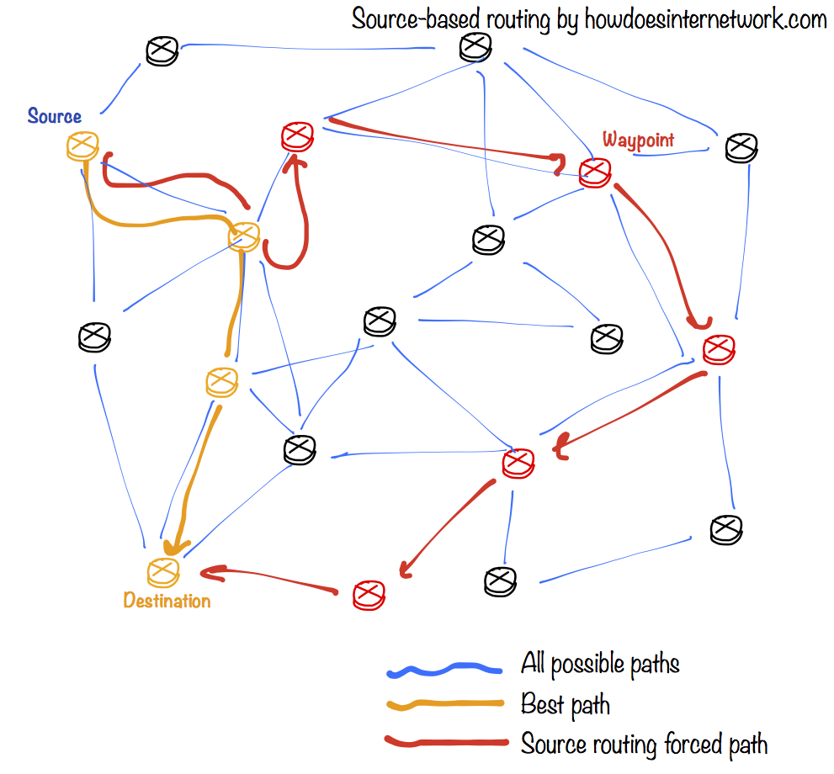
Notes:
https://en.wikipedia.org/wiki/Source_routing
In computer networking, source routing, also called path addressing, allows a sender of a packet to partially or completely specify the route the packet takes through the network.
In contrast, in conventional routing, routers in the network determine the path incrementally based on the packet's destination.

Slide 64
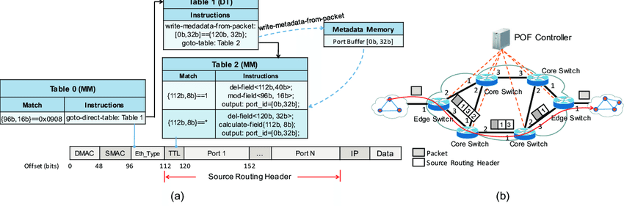
POF-based Source Routing
POF: Protocol Oblivious Forwarding
Port bound
forwarding
table
forwarding
process

Slide 65
POF-based Source Routing
POF: Protocol Oblivious Forwarding
Port bound
forwarding
table
forwarding
process
anonymity protected?

Slide 66
POF-based Source Routing
POF: Protocol Oblivious Forwarding
Port sequence leaked
forwarding
table
forwarding
process
anonymity protected? nah!

Slide 67
source routing
how to anonymize?
Notes:
allows a sender of a packet to partially or completely specify the route the packet takes through the network.
In contrast, in conventional routing, routers in the network determine the path incrementally based on the packet's destination

Slide 68
POF-based Source Routing
POF: Protocol Oblivious Forwarding
Port sequence leaked
forwarding
table
forwarding
process
should hide ports from non-neighbors

Slide 69
onion routing
source-routing based anonymous overlay communication

Slide 70
onion routing
source-routing based anonymous overlay communication
Notes:
Leverage the overlay network architecture
Otherwise, underlying forwarding devices do not support the modification

Slide 71

onion routing
source-routing based anonymous overlay communication
Notes:
Use onion router called Tor

Slide 72
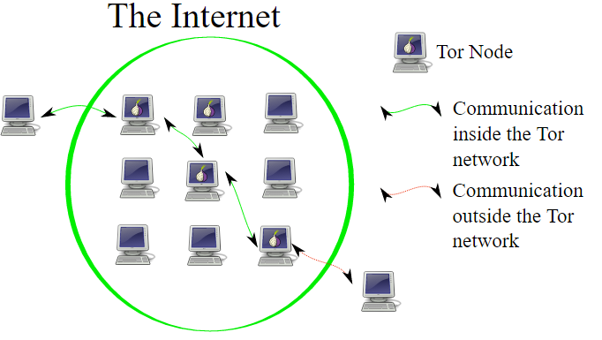
Onion Routing

Slide 73
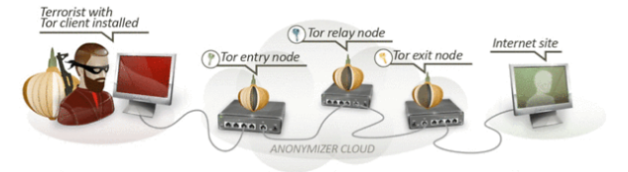
Onion Routing
Connect to Tor entry
Randomly select a series of Tors
Relay messages across them
Tor exit relays messages to destination

Slide 74
Onion Routing
Reply traffic from destination traverses
the reverse path
Maintains a bidirectional persistent
multi-hop path between source and
destination

Slide 75
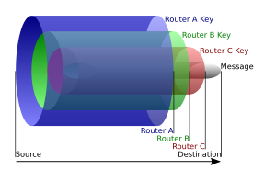
Onion Routing
B
Layered Encryption
A
C
D
{{{{msg}_{D}}_{C}}_{B}}_{A}
sufficient?
Notes:
Messge to forward is available
Yet, where to forward?

Slide 76
Onion Routing
B
Layered Encryption
A
C
D
{{{{msg}_{D},D}_{C},C}_{B},B}_{A}
sufficient

Slide 77
Onion Routing
B
Layered Encryption
Leaked routing info:
neighborship only
A
C
D
{{{{msg}_{D},D}_{C},C}_{B},B}_{A}

Slide 78
onion routing
applications?

Slide 79
Darknet
Portions of the Internet purposefully
not open to public view
or hidden networks whose architecture
is superimposed on that of Internet.
Install Tor
Access darknet.onion through it
Notes:
the portions of the Internet purposefully not open to public view or hidden networks whose architecture is superimposed on that of the Internet.

Slide 80
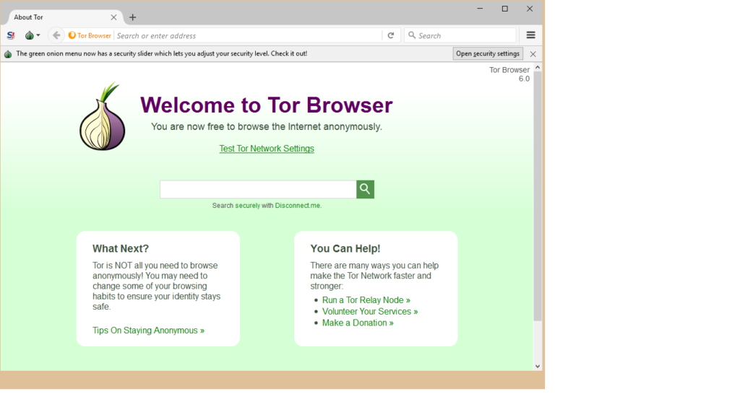
Darknet
Notes:
the portions of the Internet purposefully not open to public view or hidden networks whose architecture is superimposed on that of the Internet.

Slide 81

Darknet
Notes:
the portions of the Internet purposefully not open to public view or hidden networks whose architecture is superimposed on that of the Internet.

Slide 82
how to de-anonymization?

Slide 83
in it to win it!

Slide 84
Tor Traffic Correlation
Passive monitoring
Active attraction:
deploy a Tor router;
attract Tor traffic;
perform traffic analysis and correlation;

Slide 85
Path Selection Attack
Tor path selection algorithm:
weight nodes by selfreported bandwidth;
select each node using weighted
probability distribution;
Attack:
malicious relay reports very high bw to
increase selection probability;
if it controls the first hop, de- sender;
if it controls the last hop, de- receiver;

Slide 86
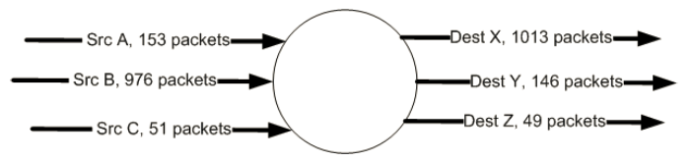
Counting Attack
Correlate incoming and outgoing flows
by counting the number of packets

Slide 87
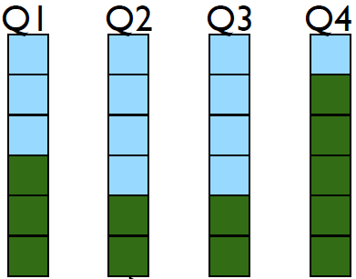
Low Latency Attack
Tor router assigns each anonymous
circuit its own queue
Dequeue one packet from each queue
in round-robin fashion

Slide 88
Low Latency Attack
Tor router assigns each anonymous
circuit its own queue
Dequeue one packet from each queue
in round-robin fashion
new queue affects
latencies of all other
queues;

Slide 89
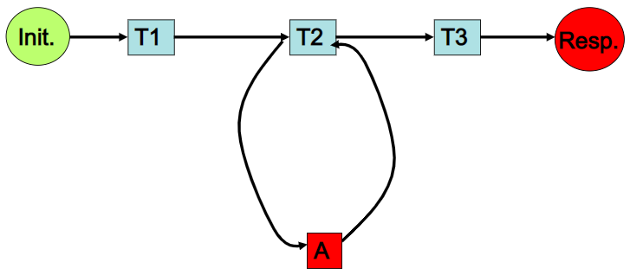
Low Latency Attack
Attacker:
intends to infer Init’s activity

Slide 90
Low Latency Attack
Attacker:
intends to infer Init’s activity
Assumption:
only Init and A occupy T2

Slide 91
Low Latency Attack
Attacker:
loop:
send packets to T2;
measure latency;

Slide 92
Low Latency Attack
larger latency indicate Init’s traffic!
Attacker:
loop:
send packets to T2;
measure latency;

Slide 93
Cross Site Attack
Crawling:
Deploy Tor routers
Access darknet
Crawl transaction information
Extract Bitcoin accounts of interest
Correlation:
Search the accounts on public websites

Slide 94
?

Slide 95
Readings
Anonymous Communication
by Nick Mathewson
Tor: The Second-Generation Onion Router (2012 DRAFT)
by Dingledine et al.
Disclaimer:
The content aims only for helping students understand
principles of anonymous communication. It should not be
used for abusive Internet activities.

Slide 96
Thank You
be on the road
Notes:
Run your own race.

